Slide 1
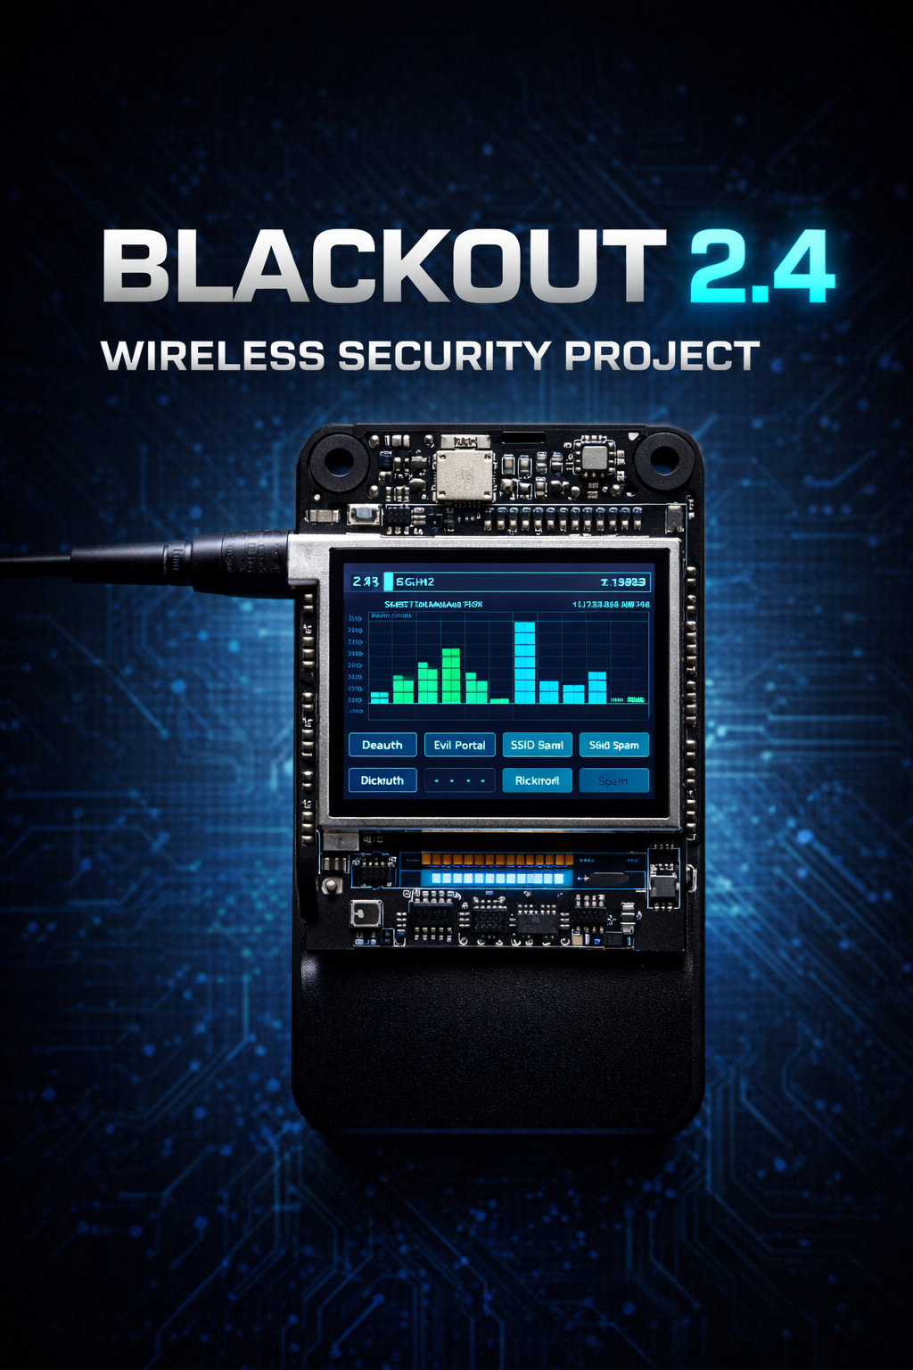
Blackout 2.4
Unveiling 2.4 GHz Network Vulnerabilities

Slide 2




Team Behind Blackout 2.4
Our team, guided by the expertise of Sir Inzamam has meticulously developed and executed this project to shed light on prevalent wireless security concerns.
Ibrar-ul-Hassan
Hassan Iftikhar
Azfar Waqas
UW-23-CY-BS-018
UW-23-CY-BS-002
UW-23-CY-BS-013

Slide 3

Why Blackout 2.4? Unpacking Our Motivation
The omnipresence of 2.4 GHz wireless networks in our daily lives, coupled with a general lack of security awareness in common devices, forms the core motivation for this project. We aim to expose how readily these networks can be compromised.
Heavy Reliance on 2.4 GHz Wireless Networks
Weak Security Awareness in Common Devices
Need to Understand Real-World Wireless Attacks
From home Wi-Fi to everyday IoT gadgets, the 2.4 GHz band is the backbone of our connected world, making its security paramount.
Many consumer-grade devices come with default or easily exploitable security settings, presenting significant vulnerabilities.
Our project seeks to demystify complex wireless attacks, demonstrating their practical execution and impact to foster better defense strategies.

Slide 4


The Crowded & Vulnerable
2.4 GHz Spectrum
The Crowded & Vulnerable 2.4 GHz Spectrum
The 2.4 GHz spectrum is a double-edged sword: universally adopted yet inherently vulnerable. Its crowded nature makes it susceptible to interference and various forms of attack that are often difficult to detect.
Crowded and Vulnerable Spectrum
Attacks are Easy to Perform but Hard to Detect
Limited Visibility of Spectrum Misuse
Numerous devices compete for bandwidth, leading to congestion and making it easier for malicious signals to blend in.
The simplicity of launching many wireless attacks belies the complexity of identifying them, leaving networks exposed.
Without specialized tools, users and administrators often remain unaware of illicit activities happening within their wireless environment.

Slide 5

Our Objectives: Illuminating Wireless Threats
PROJECT BLACKOUT 2.4
NETWORK SECURITY
"Blackout 2.4" is a network security project focused on the detailed analysis and exploitation of the 2.4 GHz wireless spectrum. Our core objectives center around bringing clarity to the often-invisible threats lurking in our wireless environments.
1
Analyze 2.4 GHz Wireless Activity
We aim to meticulously monitor and dissect traffic within this band to identify anomalies and potential vulnerabilities.
2
Demonstrate Common Wireless Attacks
Through practical demonstrations, we will showcase how readily prevalent attacks can be executed.
3
Highlight Security Risks and Misuse Scenarios
Our findings will underscore the real-world implications of insecure wireless practices and potential malicious uses.

Slide 6

DE-Authentication Frames
Targeted Frequencies: The 2.4 GHz ISM Band
Our project specifically focuses on the 2.4 GHz Industrial, Scientific, and Medical (ISM) band, a global unlicensed frequency spectrum crucial for a myriad of wireless communications.
2.4 GHz ISM Band
Wi-Fi (802.11 b/g/n)
The primary target for our analysis, due to its widespread adoption and inherent vulnerabilities.
The most common technology in this band, connecting countless devices to the internet.
Bluetooth & BLE Devices
Short-range communication protocols for peripherals, audio, and IoT, also operating within this frequency.

Slide 7

Attack Vector Showcase: Demonstrating Wireless Exploits
This project will practically demonstrate a range of common wireless attacks, showcasing their mechanisms and potential impact on unsuspecting users and networks.
1
2
3
Wi-Fi Deauthentication
Evil Portal
Rick Roll Attack
Forcing devices off a Wi-Fi network, disrupting connectivity and creating opportunities for further attacks.
Setting up a rogue access point to intercept credentials or deliver malicious content.
A humorous yet disruptive attack redirecting users to unexpected content.
4
5
Clone & Spam Attacks
Bluetooth Spamming
Duplicating network identities and flooding targets with overwhelming traffic.
Overwhelming Bluetooth devices with unwanted connection requests and notifications.

Slide 8

System Overview
To effectively execute and monitor these demonstrations, we developed a portable embedded attack platform. This self-contained system allows for versatile and on-the-go wireless exploitation and analysis.
Portable Embedded Attack Platform
Touch-Based Interface
Intuitive control and real-time feedback for seamless interaction during demonstrations.
Designed for mobility, enabling security testing in various environments.
Wireless Attack Execution & Monitoring
Capable of launching various attacks while simultaneously observing their effects.

Slide 9




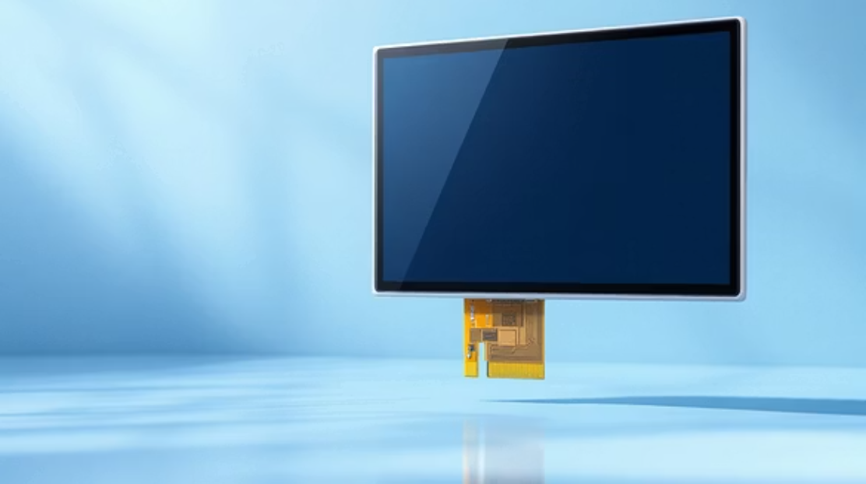







Hardware Backbone: The Foundation of Blackout 2.4
The physical components forming the core of our attack platform are carefully selected for their capabilities in wireless communication and interactive display.
ESP32 Microcontroller
2.8” TFT Touch Display
Breadboard & Jumper Wires
The brain of our system, providing powerful processing and integrated Wi-Fi/Bluetooth capabilities.
Enables user interaction and visual feedback, making the platform user-friendly and intuitive.
Facilitates rapid prototyping and flexible connections between components for testing and development.

Slide 10

Software Core: Powering the Exploitations
The intelligence of our Blackout 2.4 platform stems from its robust software components, specifically tailored for wireless interaction and user control.
01
02
ESP32 Firmware
Wi-Fi & BLE Libraries
Custom-developed software loaded onto the microcontroller, orchestrating all hardware functions.
Essential programming interfaces enabling seamless communication and manipulation of the 2.4 GHz spectrum.
03
Touch UI & Control Logic
The interactive element, translating touch inputs into commands and presenting real-time data to the user.

Slide 11




Blackout 2.4: Core Functional Capabilities
Blackout 2.4 is designed with a suite of functional capabilities that allow for comprehensive analysis and simulation of wireless network vulnerabilities. These features provide a powerful toolkit for understanding and demonstrating potential attack vectors in a controlled environment.
Spectrum Scanning
Channel Monitoring
The device can actively scan and identify all available Wi-Fi networks in its vicinity, mapping out the wireless landscape. This allows for detailed reconnaissance of target environments.
Beyond simple scanning, Blackout 2.4 provides real-time monitoring of specific Wi-Fi channels, observing data traffic and identifying active devices and potential points of interest.
Attack Triggering
Real-Time Feedback
Equipped with the ability to initiate various simulated attacks, the system can demonstrate the impact of different exploit techniques, providing practical insights into network security.
During simulations, Blackout 2.4 offers immediate feedback on the success and impact of triggered actions, allowing for instantaneous adjustments and deeper understanding of attack dynamics.

Slide 12
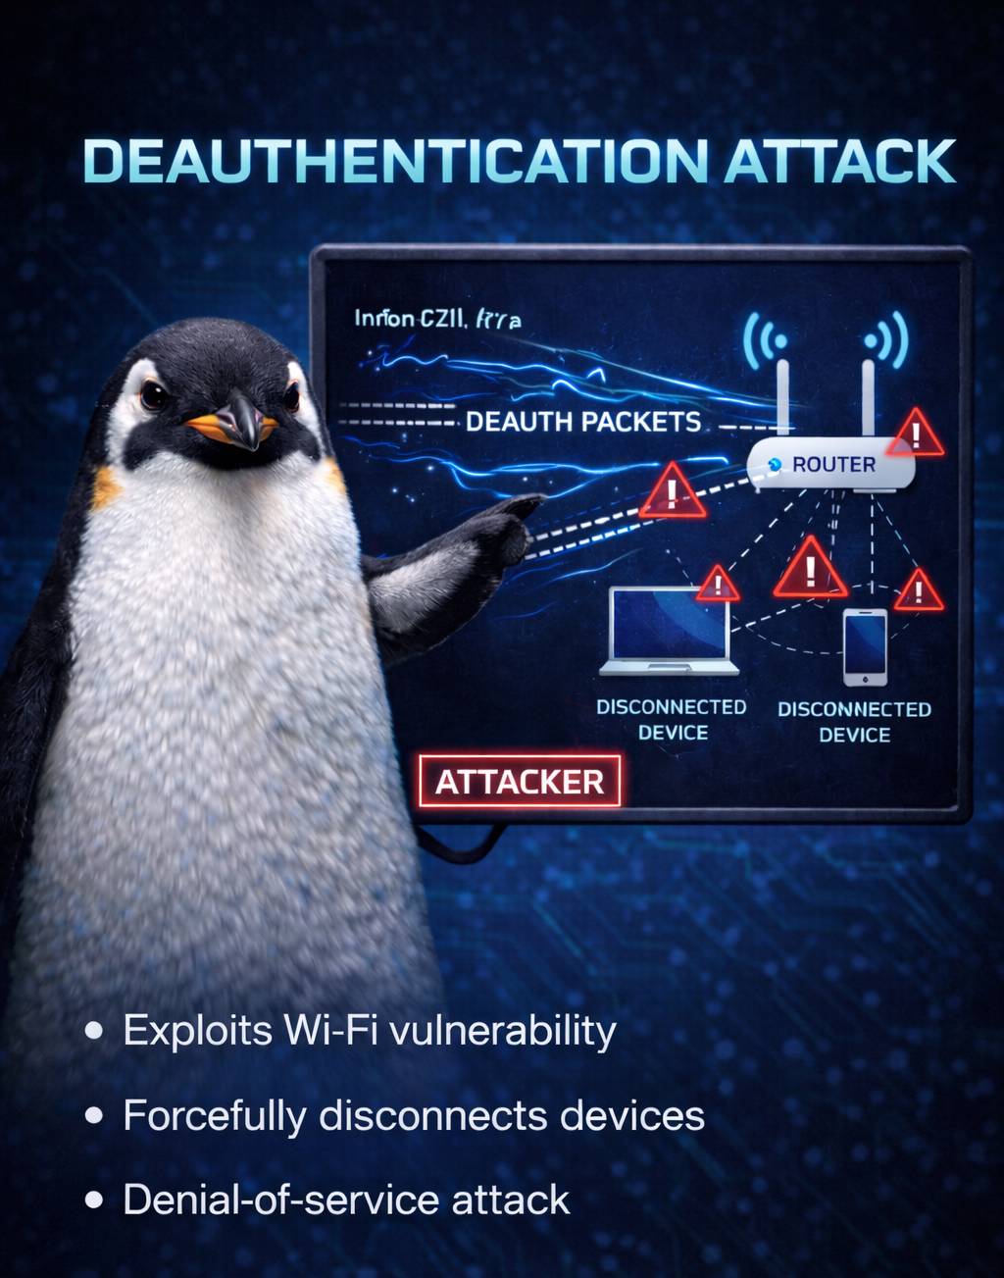
Understanding the Deauthentication Attack
The deauthentication attack is a fundamental and highly effective method for disrupting wireless network connectivity. This simulation demonstrates a critical vulnerability within the 802.11 standard.
Mechanism of Attack
Forces clients off Wi-Fi networks by sending spoofed deauthentication frames.
Exploits the lack of authentication in 802.11 management frames.
No encryption or authentication is required for these frames, making them highly susceptible to abuse.
This type of attack essentially tells a client device that it is no longer authorized to be connected to a specific Wi-Fi network, causing it to disconnect. While seemingly simple, its implications for network stability and user access are significant.
A deauthentication attack highlights a core design flaw in legacy Wi-Fi protocols, making it a critical demonstration for understanding denial-of-service vulnerabilities.

Slide 13
NOVELTY
Simulating an Evil Portal Attack
The Evil Portal attack showcases a sophisticated form of social engineering by creating a deceptive environment to trick users into divulging sensitive information. This demonstration highlights the dangers of trusting unknown network access points.
Fake Access Point Creation
Credential Harvesting
Social Engineering in Action
Once connected, users are often redirected to a fake login page (the "portal") that closely resembles a legitimate service (e.g., public Wi-Fi login, email, social media). This simulates the process of capturing usernames and passwords.
Blackout 2.4 can simulate an unauthorized Wi-Fi access point, often mimicking legitimate networks. This 'evil twin' lures unsuspecting users into connecting to it instead of the real network.
This attack is a prime example of social engineering, where human psychology is exploited to gain access to information. It underscores the importance of verifying network legitimacy before entering credentials.

Slide 14




Exploring Bluetooth Attack Vectors
Beyond Wi-Fi, Blackout 2.4 also explores vulnerabilities within Bluetooth Low Energy (BLE) protocols, demonstrating how seemingly innocuous features can be exploited for disruptive purposes. These attacks highlight the need for robust security across all wireless communication standards.
Device Confusion & Disruption
By creating a multitude of phantom devices, real devices can become confused, leading to connection failures, battery drain, and general operational instability for Bluetooth-enabled gadgets.
BLE Advertisement Spam
The device can flood an area with numerous fake BLE advertisements, overwhelming nearby devices and making it difficult for legitimate connections to be established or maintained.
Misuse Risks Illustrated
This demonstrates how common Bluetooth features, intended for convenience, can be repurposed for malicious activities, underscoring the broader security challenges in IoT and connected devices.

Slide 15
Testing and Verifying Attack Execution
Rigorous testing was conducted to ensure the Blackout 2.4 system reliably performs the simulated attacks. The results consistently demonstrated successful execution, stable performance, and immediate, observable effects on target networks and devices.
100%
ESP32
Real-Time
Attack Success Rate
Stable Performance
Immediate Response
All simulated attacks, including deauthentication, evil portal, and Bluetooth spam, executed with a 100% success rate in controlled test environments.
The ESP32 microcontroller maintained stable operation throughout all testing phases, handling resource-intensive tasks without crashes or significant performance degradation.
Target devices and networks exhibited instantaneous responses to the triggered attacks, confirming the effectiveness and real-time impact of the Blackout 2.4 system.
Observational data confirmed that client devices were successfully disconnected, fake access points were established, and Bluetooth devices were overwhelmed with advertisements, validating the system's capabilities.

Slide 16

Ethical Considerations and Responsible Usage
The development and use of tools like Blackout 2.4 come with significant ethical responsibilities. It is paramount that such technologies are used strictly for educational purposes and within controlled, authorized environments to prevent harm and ensure compliance with legal and ethical guidelines.
Educational Use Only
Lab-Controlled Environment
No Real User Data Targeted
Blackout 2.4 is designed as a learning tool to help students and professionals understand wireless security vulnerabilities and defense mechanisms. It is not intended for malicious activities.
All demonstrations and testing were conducted within isolated, lab-controlled settings where no external networks or unauthorized devices were affected. This ensures responsible research and development.
During any simulated credential harvesting or disruption, no actual user data was targeted, collected, or compromised. The focus remains purely on demonstrating the attack mechanism, not on exploiting individuals.
Users are strictly advised to adhere to all local laws and regulations regarding wireless network testing and ethical hacking. Misuse of such tools can lead to severe legal consequences.

Slide 17
Conclusion: The Pervasive Vulnerabilities of 2.4 GHz
Our exploration with Blackout 2.4 conclusively demonstrates that the widely used 2.4 GHz wireless spectrum, despite its ubiquity, remains highly susceptible to various straightforward yet highly effective attacks. This highlights an urgent need for increased awareness and more robust security practices.
2.4 GHz is Highly Exploitable
Attacks Are Simple Yet Effective
Security Awareness is Critical
The common 2.4 GHz band, used by Wi-Fi and Bluetooth, is prone to vulnerabilities stemming from outdated protocols and widespread device compatibility requirements. This makes it a prime target for various forms of attack.
As demonstrated, attacks like deauthentication and evil portals require minimal technical sophistication to execute but can have significant disruptive impacts, affecting connectivity and data security.
The ease with which these attacks can be performed underscores the critical importance of user and administrator awareness. Education, strong password practices, and vigilance against suspicious network behavior are essential defense mechanisms.

Slide 18

Thank You for Your Attention!
Any Questions?
.

